Slide 1


Lecture Topic 16: Value and Valuation – Pulling it All Together
Presentation to Cox Business Students
FINA 3320: Financial Management
Presentation to Cox MBA Students
FINA 6214: International Financial Markets

Slide 2
What is Valuation?
In finance valuation of securities defined to be:
  The present value of the security’s future cash flows discounted to the present using the risk-adjusted discount rate
To accomplish this task, we need to understand:
  DCF method (already done!)
  Concept of Free Cash Flows (FCFs)
  Weighted Average Cost of Capital (WACC)
  Net Present Value (NPV)

Slide 3
Question?
What is the Cost of Capital to a levered firm?

Slide 4
Answer
The Cost of Capital must reflect the average cost of the various sources of long-term funds used
  The Discount Rate (i.e., Cost of Capital) applied to future cash flows should reflect the opportunity cost to all capital providers
This average opportunity cost is called WACC!
  The opportunity cost to a class of investors equals the rate of return the investors expect to earn on other investments of equivalent risk

Slide 5
Free Cash Flows
FCFs are cash flows available to all the firm’s stakeholders
  e.g., Creditors and shareholders
FCFs defined as cash flows from operations net of various required investments in the firm
  e.g., Investments in fixed assets, working capital, R&D, advertising, etc.
From financial accounting the following represents a pro forma income statement...

Slide 6
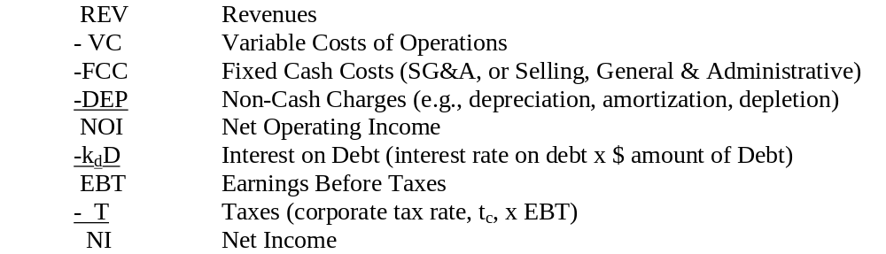

Slide 7
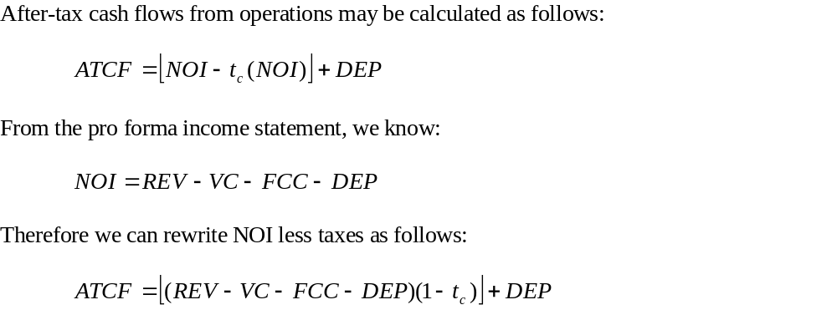
Calculating FCFs
After-tax cash flows (ATCFs) from operations is Net Operating Income (NOI) less Taxes (t_{c}):

Slide 8
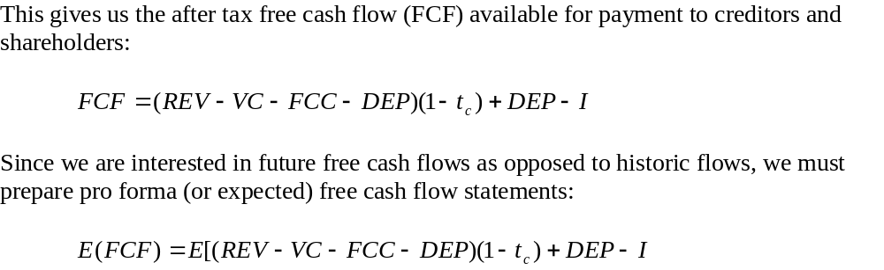
To convert ATCF to FCF requires accounting for expenditures including:
    P&E: plant and equipment
    Investments in working capital
    R&D expenses
    Advertising, etc.

Slide 9
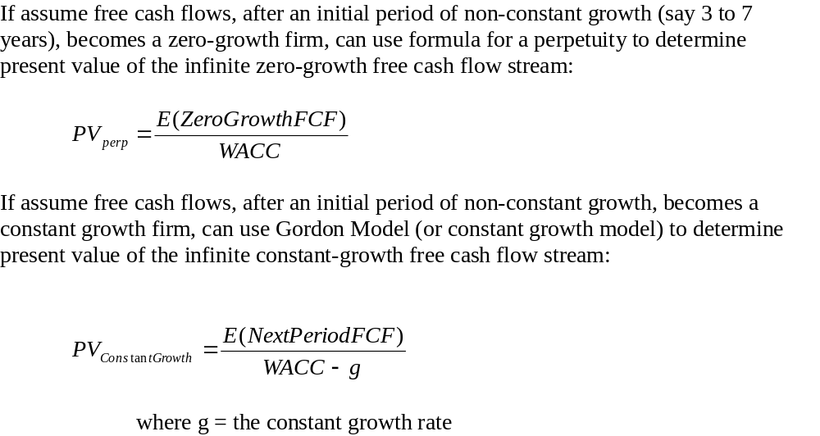
Determining All the Firm’s FCFs
Necessary to determine all future FCFs
    Corporations have infinite life therefore infinite FCFs

Slide 10
Determining WACC
The 4-step process to determine appropriate discount rate, or WACC, for discounting FCFs of the project (or the firm)
  (1) Determine firm’s optimal capital structure
  (2) Determine firm’s capital requirements (i.e., I)
  (3) Determine firm’s component costs of capital
  (4) Determine firm’s WACC
    After calculating firm’s WACC (appropriate cost of capital for firm’s average risky project), need to determine project’s WACC based on specific project risk compared to risk of firm’s average project

Slide 11
Step 1: Optimal Capital Structure
Optimal capital structure maximizes firm’s value
    This structure minimizes the firm’s WACC
    WACC is rate used to discount all firm’s FCFs
    Minimizing WACC increases present value of FCFs
How can firm obtain optimal capital structure?
    Cost of debt never greater than cost of equity for same firm due to:
      Bankruptcy liquidation preference (equity as ‘residual claimant’)
      After-tax costs are appropriate costs
        Tax deductibility of interest on debt
        Dividends paid in after-tax dollars
Implies greater debt = lower WACC (M&M)

Slide 12
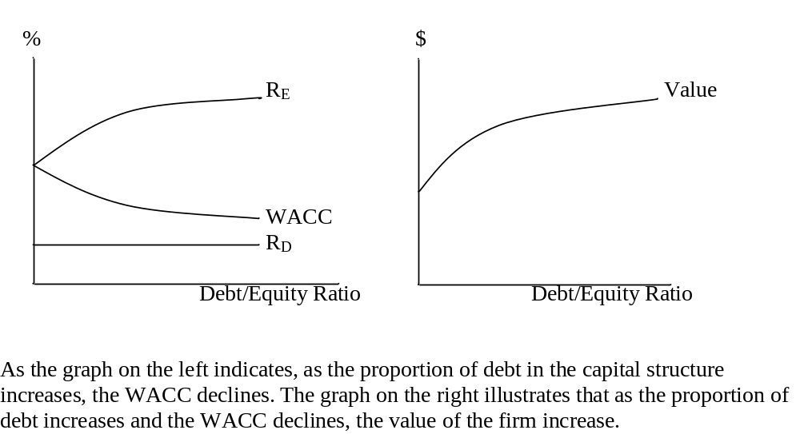

Slide 13
M&M show that with taxes optimal capital structure is close to 100% debt
  However, M&M failed to consider financial distress costs and agency costs
Financial distress, or bankruptcy, costs
  As a firm increases its proportion of debt, the interest increases because of two items
    The dollar amount of debt increases
    The risk, and therefore the interest rate, increases
  As interest increases, the probability of default increases and so does the costs associated with bankruptcy
    Legal fees, loss of asset value, decreased sales, loss of key employees, loss of trade credit, etc.

Slide 14
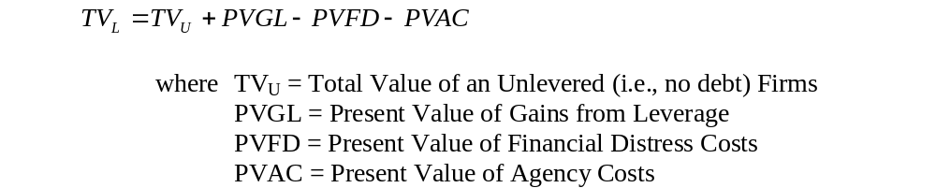
Agency cost of debt
  As more debt is used to finance firm, shareholders may pressure management to undertake more risky projects
    Referred to as “bondholders’ wealth expropriation”
    Therefore, bondholders must write covenants and contracts to avoid this problem
    Cost of writing and enforcing these covenants and contracts are part of the agency cost of debt
M&M’s model must be adjusted to reflect these costs:

Slide 15
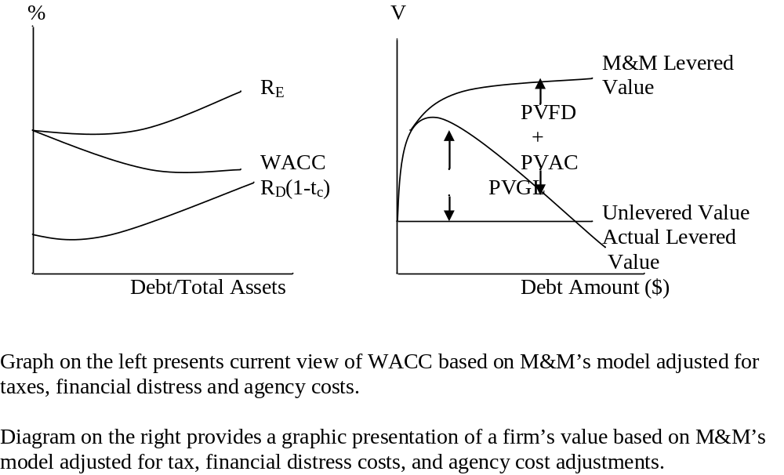

Slide 16
Step 2: Capital Requirements (I)
Determining the dollar amount of new investment required by the firm including:
  Land, Plant and Equipment
  Working Capital
  Capital Budgeting Projects
  Repurchase of Outstanding Debt and Equity
  Dividend Payments
  R&D Expenditures
  Advertising, etc.
Required for each year of the pro forma financials

Slide 17
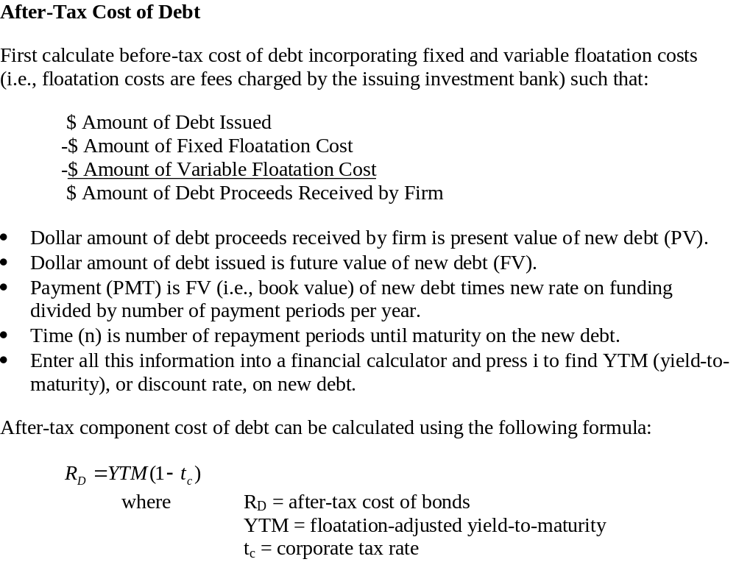
Step 3: Component Costs of Capital

Slide 18
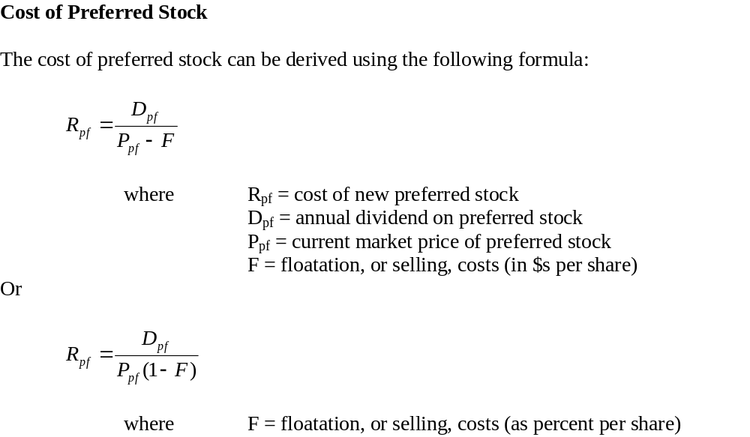

Slide 19
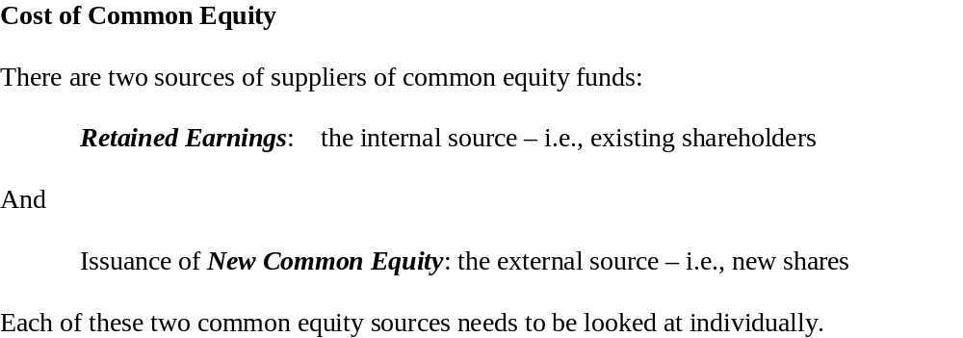

Slide 20
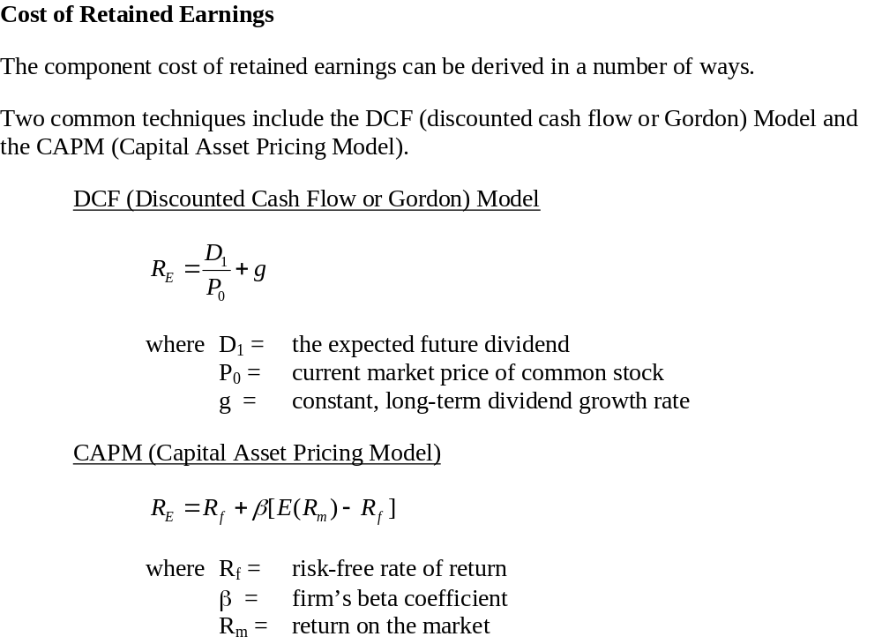

Slide 21
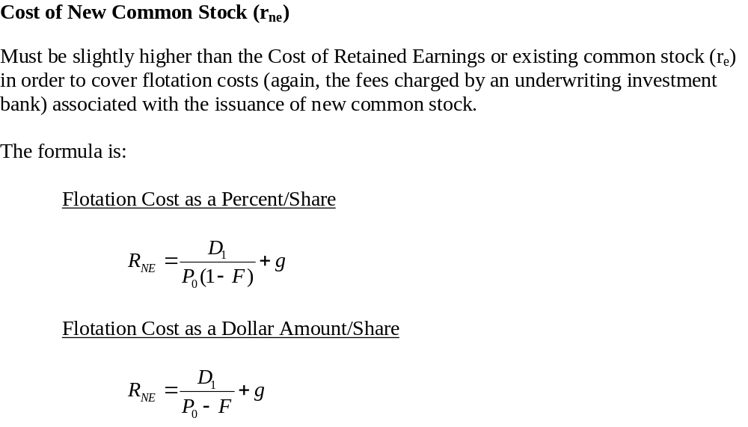

Slide 22
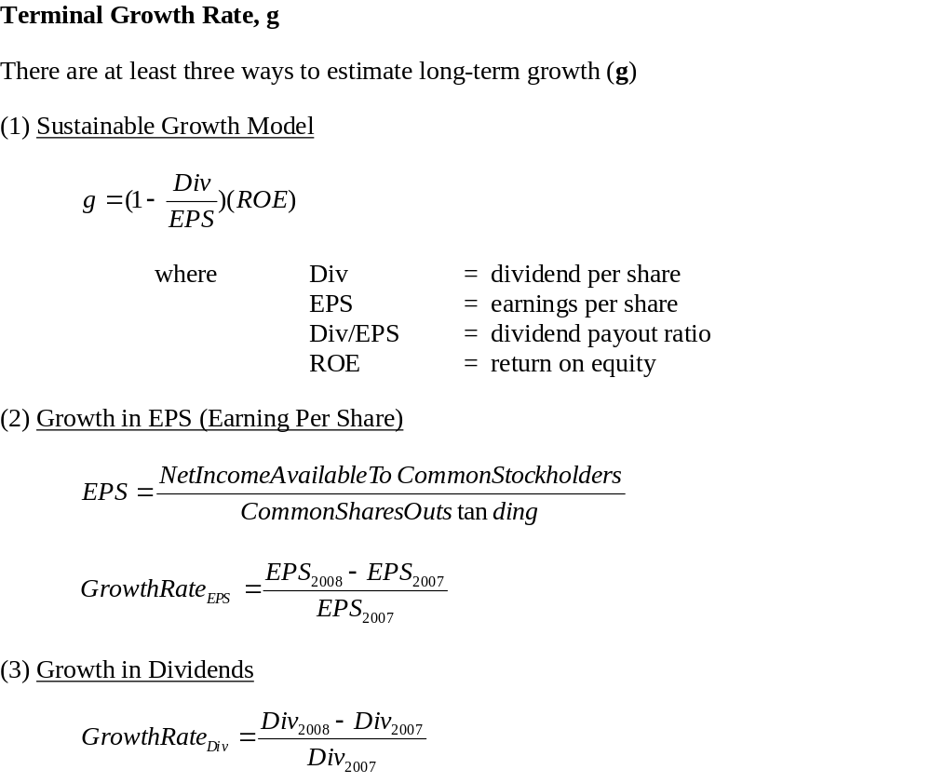

Slide 23
Step 4: WACC
First, obtain component weights from optimal capital structure (Step 1)
  Debt %
  Preferred Stock %
  Retained Earnings %
  New Common Stock %
Second, obtain component costs (Step 3)
Third, multiply component weights with respective component costs and sum:

Slide 24
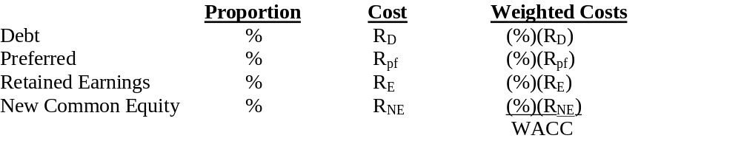

Slide 25
Determine Project’s WACC
Firm’s cost of capital defined as expected return on portfolio of all company’s projects
  Used to discount FCFs on projects of average risk
  Not the proper discount rate to use if project not average risky
Each project should be evaluated at its own opportunity cost of capital
  True cost of capital dependent on project risk
Why estimate firm’s cost of capital?
  Majority of projects can be treated as average risky
  Firm’s cost of capital good starting point

Slide 26
Determine Firm’s Valuation
We have…
  (1) Determined firm’s (or project’s) FCFs
  (2) Calculated firm’s (or project’s) WACC
Final step is to calculate the present value of the stream of the firm’s (project’s) FCFs using WACC as the discount rate
  This present value is the firm’s (project’s) total valuation
Subtracting market value of the firm’s debt provides price of firm’s equity

Slide 27
What if FCFs are Wrong?
What if project’s FCFs are overestimated?
  The project’s valuation will be too high
  Realized project returns will probably be lower than anticipated
  Value of firm will probably be less than projected
  Project may end up being a negative NPV undertaking
What if project’s FCFs are underestimated?
  The project’s valuation will be too low
  The project may fail to meet benchmark or hurdle and therefore be rejected (not undertaken)
  Value of firm will probably not be maximized

Slide 28
What is WACC is Wrong?
What is the project’s WACC is too low?
  The valuation of the project will be too high
  Realized project returns will probably be lower than anticipated
  Value of firm will probably be less than projected
  Project may end up being a negative NPV undertaking
What if project’s WACC is too high?
  The project’s valuation will be too low
  The project will fail to meet benchmark or hurdle and therefore be rejected (not undertaken)
  Value of firm will probably not be maximized

Slide 29
Sensitivity Analysis
FCFs and WACC have a significant impact on a capital budgeting project’s valuation
Both require sensitivity analysis of the base case:
  Increase FCF by fixed percent (e.g., 10%) and view changes in NPV
    Holding all else constant
  Increase WACC by a fixed percent (e.g., 10%) and view changes in NPV
    Holding all else constant
  Finally, change the terminal growth rate, g, and other variables view changes in NPV (to determine key variables)
    Holding all else constant

Slide 30
Question?
What is the difference between a company’s cost of capital versus a project’s cost of capital?

Slide 31
Answer
The company’s cost of capital is defined as the expected return on a portfolio of all the company’s existing securities (or projects)
  This rate is used to discount the free cash flows on average risky projects of the company
  This is not the proper rate to use if the project is more or less risky than the average risky project
Each project should be evaluated using its own opportunity cost of capital

Slide 32
Question?
So, based on the previous answer, why is so much time spent estimating the company’s Cost of Capital?

Slide 33
Answer
First, many (and perhaps the majority) of projects can be treated as average risk
  These projects are no more or less risky than the average of the company’s other projects or assets
Second, the company’s cost of capital is a useful starting point for setting discount rates for unusually risky or safe projects
  Easier to adjust the company’s cost of capital than to determine the discount rate for each project!

Slide 34
The Enterprise DCF Model
An General Overview

Slide 35
The Enterprise DCF Model
Enterprise DCF model values the entire firm
  And then subtracts the value of debt and preferred equity to obtain common equity value
Enterprise DCF model useful in multi-business firm
  Value of firm is sum of values of each operating unit
Enterprise DCF model values components of firm that add up to enterprise value instead of just value of equity
  Assists managers identify and understand separate investment and financing sources of value
  Helps managers pinpoint key leverage areas and aids in search for value-enhancing ideas
  Model can be applied consistently at various levels of aggregation

Slide 36
The Enterprise DCF Model
Agile Technologies, Inc.:
An Example

Slide 37
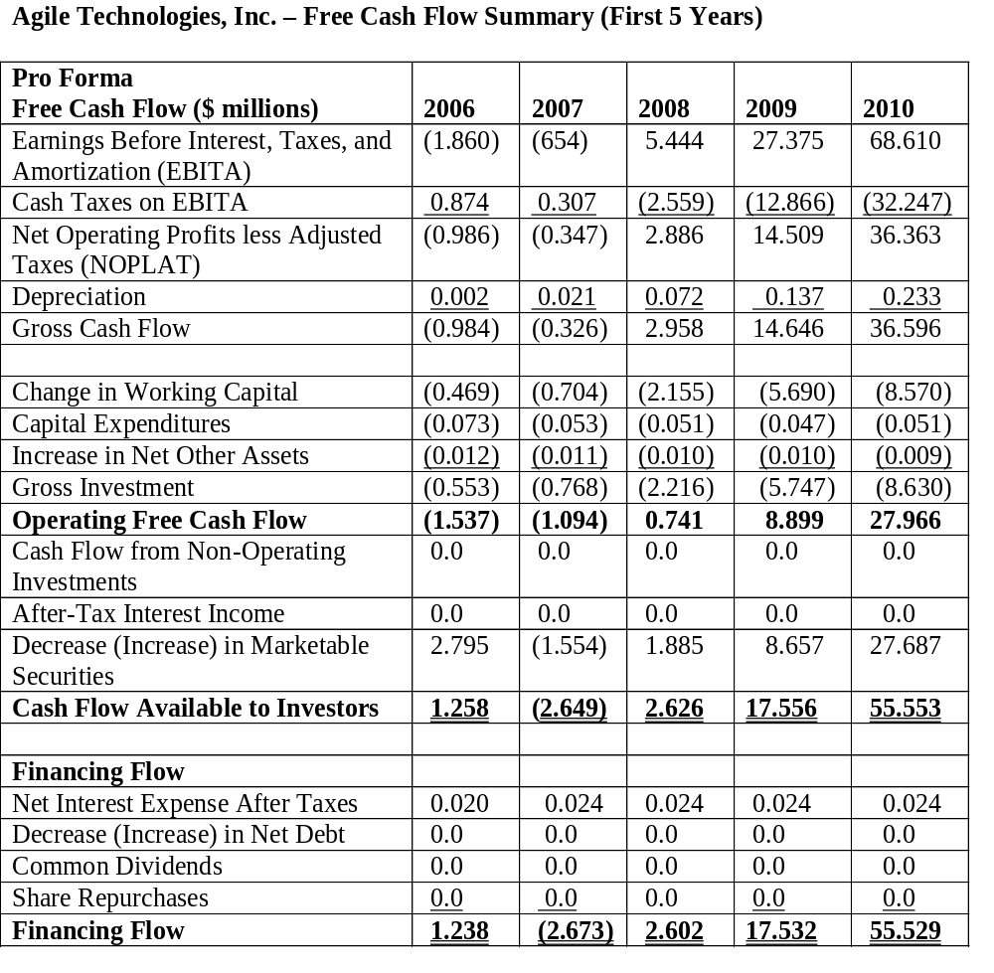

Slide 38
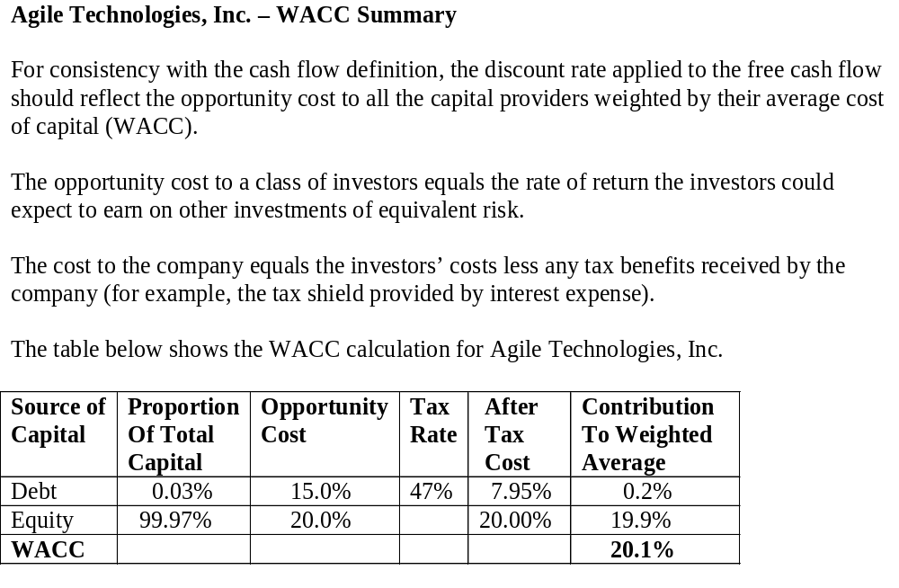

Slide 39
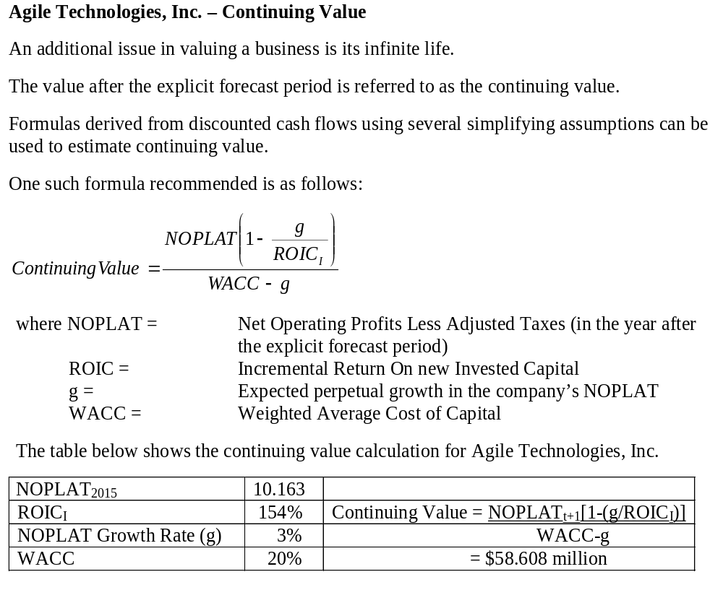

Slide 40
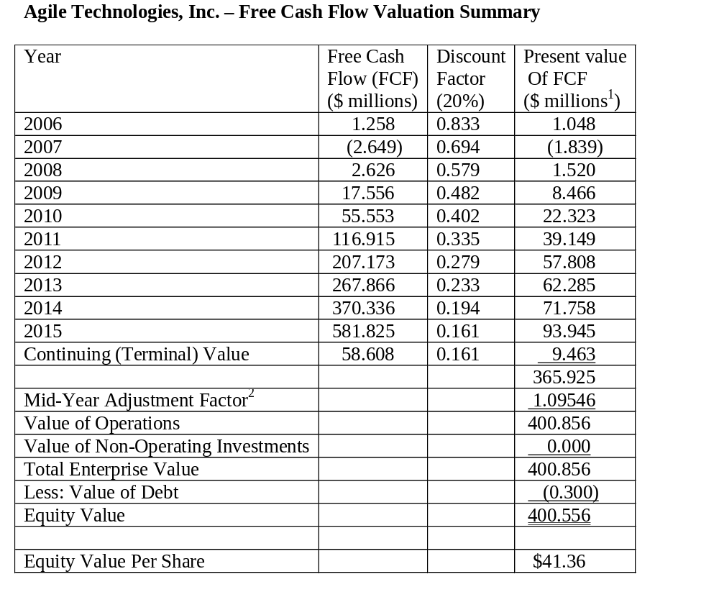

Slide 41
Value of Debt and Value of Equity
The value of a company’s debt
  Equals the present value of cash flow to debt holders discounted at the risk-adjusted rate
  Discount rate used should be equal to current market rate on similar risk debt with comparable terms
The value of a company’s equity
  Is the value of its operations plus non-operating assets
    e.g., Investments in unrelated, unconsolidated businesses
  Less value of its debt and any non-operating liabilities
The value of Agile Technologies, Inc. equity
  Is $400.556 million

Slide 42
What Drives FCF and Value?
Value is based on discounted FCFs and underlying value drivers also must be based on FCFs
Two key value drivers of FCFs:
  ROIC: Return on Invested Capital
    Company that earns higher profits for every dollar invested will be worth more than similar company that earns less profit on each dollar invested
  Growth Rate: of company’s revenues, profits, and capital base
    Faster growing company will be worth more than a slower growing company if both are earning the same ROIC
To increase value, company must
    (1) Increase level of profits it earns on existing capital
    (2) Ensure return on new capital investment exceeds WACC
    (3) Increase its growth rate, but only if ROIC exceeds WACC
    (4)Reduce its cost of capital

Slide 43
Art of Valuation
Valuation is a function of:
  Understanding the business (analyzing the firms)
  Understanding the industry (comparative analysis)
  Understanding the general economic environment
  Prudently incorporating this information into the valuation model
  Correct method is the easy part!

Slide 44
Art of Valuation
Requirements of the valuation model:
  Pro forma model must include complete income statement, balance sheet, and cash flow statement (which ties the first two items together!)
    Supporting ratios should also be included
  Ground pro forma model in historical analysis
  Complete a similar, though less detailed, analysis for competitors

Slide 45
Where is Value?
The Value Creation Pyramid
Sources of Value Creation

Slide 46
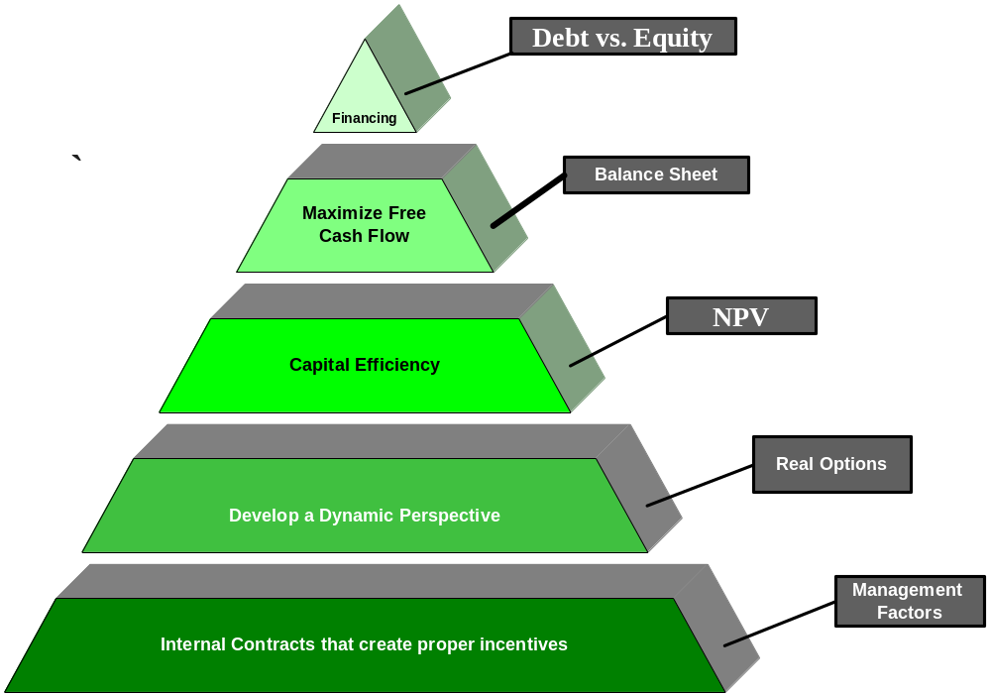

Slide 47
Brief Mention of the Top
Financing
  Adding debt brings tax savings
    Interest is tax deductible to the firm
  But adding debt incurs risk
    Debt increases the probability of future financial distress (bankruptcy)
    Cost of debt depends on market risk premia
Cash is King!
  Management’s job
    Manage firm so as to maximize free cash flow
NPV is only as good as the forecasted cash flows
  Incentives to manipulate CFs in many firms explains why this is in the middle of the pyramid

Slide 48
Method versus Process
The base of the value pyramid is process
  Management factors
    Internal contracts creating properly aligned incentives for value creation
Historically, most – if not all – of the focus in corporate finance was on method (top three cells)
But consulting with CFOs makes it clear that bad process can destroy the best method!
  With a good process, method is
    (1) Not all that important, and
    (2) Usually optimized (i.e., it is secondary to process)
Process forms the basis for value creation!

Slide 49
Harsh Realities
Wall Street places an increasingly high premium on “transparency”
The internal budgeting process affords a vehicle to:
  Communicate corporate expectations
  Characterize perceived business opportunities
  Define managerial ability to execute the business plan
Does Wall Street’s attention to quarterly earnings targets damage long-run value creation?
  Some of the blame should be placed on management’s unwillingness to expand the scope of the “message space” in communications with the Street!

Slide 50
Real Options
A dynamic focus means that when you, as a manager, make a decision, you do not act as if you are committing the firm to a locked-in stream of future cash flows
Rather, you are positioning the firm to make future decisions
The key is identifying the optimal reaction to future states of nature

Slide 51
Big Picture: Dynamic Optimization
A problem with most firms is the focus on the short-term or static optimization
There is no easy way to trade-off the competing needs to induce discipline, discourage shirking, and assess talent on the one hand from inducing creativity and a long-term perspective, on the other hand

Slide 52
Conclusion: Some Additional Sources of Value Creation
Transparency
  Increase in analysts’ coverage
Attracting new investors
  Increasing demand for the firm’s stock
Improved operating performance
  Providing better incentives and focus
Improved corporate governance
  Optimal board makeup, stock option awards, etc.
Increase strategic flexibility
  Real options analysis

Slide 53
Thank You!
Charles B. (Chip) Ruscher, PhD
Department of Finance and Business Economics

